Slide 1
The Villages Amateur Radio Club
General Membership Meeting
November 16, 2023
Notes:
1

Slide 2
TVARC
General Membership Meeting
Agenda
6:00 PM Sign in and chit-chat
6:45 PM Business Meeting
7:20-ish PM Adjourn Business Meeting
7:30-ish PM Program: Tell Us About Your Antenna

Slide 3
TVARC
Business Meeting
Pledge of Allegiance
Introduction of new members and guests
Birthdays and anniversaries
President’s report
Treasurer’s report
DXCC Standings
Break
Program

Slide 4
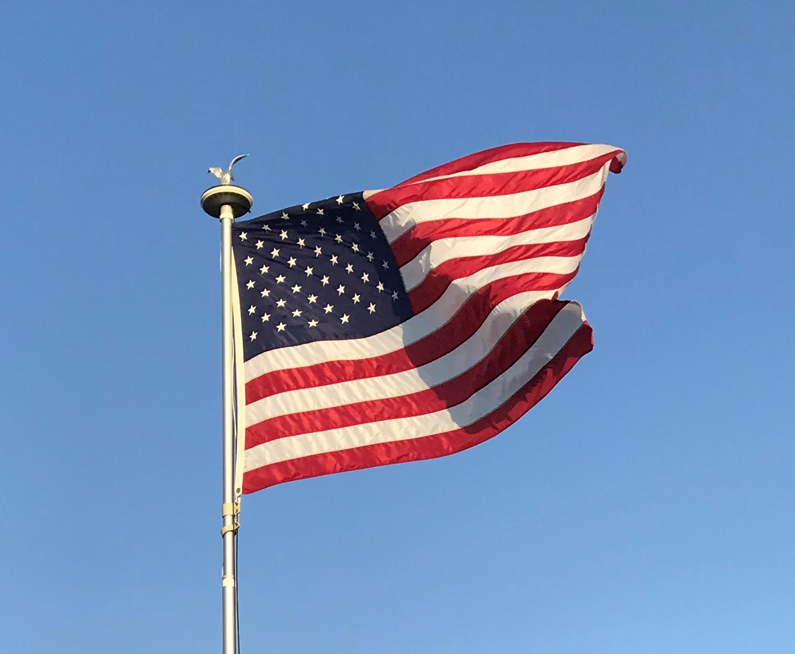

Slide 5
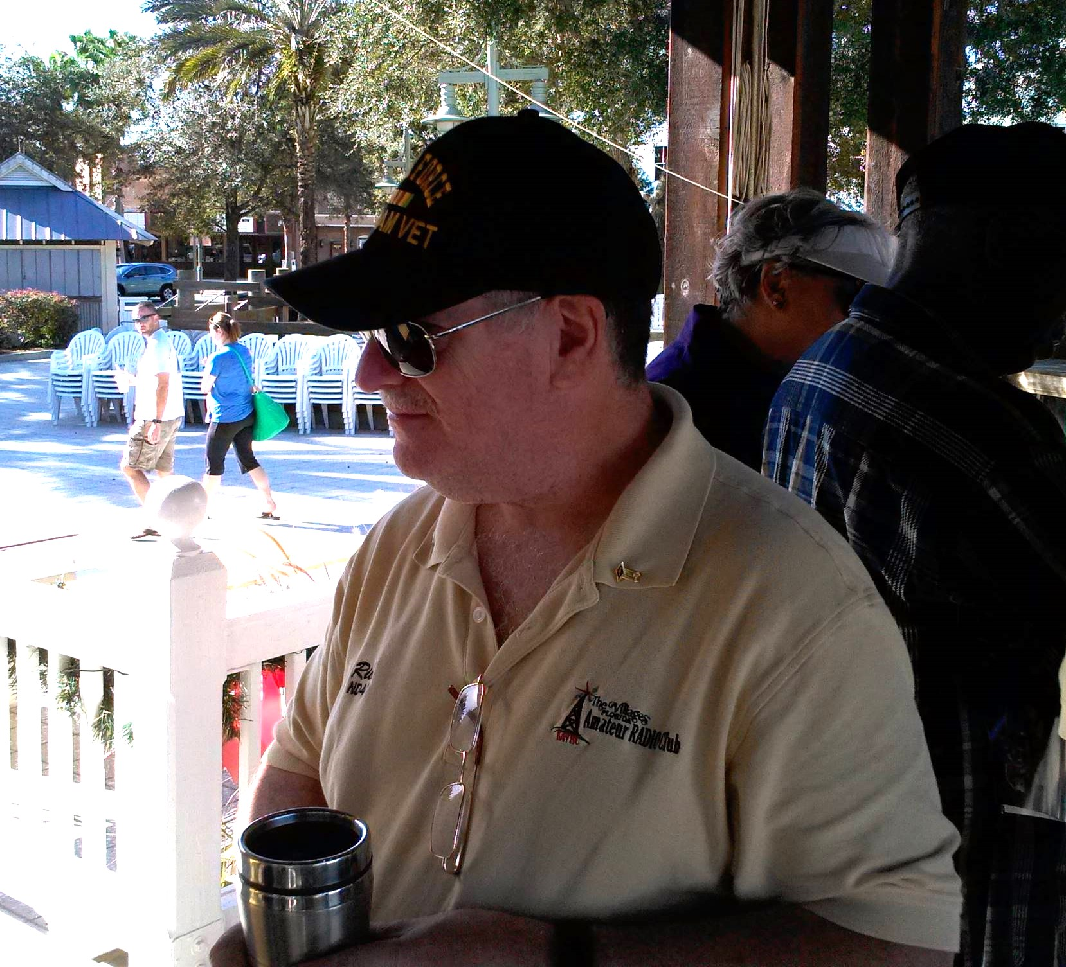
RIP RICH ERLICHMAN, ND4G
USAF veteran
Very willing to help anyone
Past TVARC President
TVARC Board Member at Large
TVARC webmaster for years
Volunteer Exam Coordinator
Loved RTTY contests
Loved his Flex transceiver
Proud of his ground screen radial solution

Slide 6
TVARC
President’s Report
Radio on the Square is THIS Saturday -
  Arrive at Lake Sumter Landing around 7:30 for setup
  KM4ZTE is compiling a list of who will bring what
  Two stations will be set up: FT8 and SSB/CW
  N8NBE got us good press in the Daily Sun
  Event runs from 9:00AM to 2:00PM

Slide 7
TVARC Radio On the Square 2023 - List of Items Needed
Item | Who | Notes
CW/SSB station with power supply & mic | * | Icom IC-7300
Laptop for CW/SSB station
Paddle for CW
FT8 station with power supply | * | Icom IC-7300
Laptop for FT8 station | K2DM
Large External Monitor for FT8 station | K9TUW
Antenna for CW/SSB station | K2DM | Hy Gain 2-el yagi
Mast for CW/SSB antenna | KM4PIH* | Paul Nittel
Antenna for FT8 station
Mast for FT8 antenna (from locker) | *

Slide 8
Coax (from locker) | *
Public Address Amp with Speaker
Rope (from locker) | *
Table #1 | KM4ZTE
Table #2 | K2DM
Table #3 | N0SMX* | Faith Olen
Table #4 | W4GOR* | George Rutkoskie
Table #5 | WB8PKK* | Ken Burstall
Table #6 | N0SMX* | Dennis McKinney
Information about license classes | KN9B* | Brad Castelli
Information about Amateur Radio | KN9B | Brad Castelli
TVARC membership forms | Bruce
Canopy (from locker) | *
Concrete blocks for canopy

Slide 9
Yellow banner (from locker) | *
Caution tape (from locker) | *
Extension cord w outlet strip | WB8PKK | Ken Burstall
Extension cord w outlet strip | WB8PKK | Ken Burstall
Extension cord w outlet strip | N0SMX | Faith Olen
Step ladder #1 | N0SMX* | Dennis McKinney
Step ladder #2
Other __________________________
Chairs (The Villages Recreation will provide chairs but not tables)
* K2DM and KM4ZTE will get these items from the locker.

Slide 10
ROS Volunteers
Setup: K2DM, KM4ZTE, N0SMX, N4FMO, KM4PIH, WB8PKK, John Callen
Operate: NP2B, K2DM, N0SMX, N4FMO, WB2ART, WB8PKK
Ambassadors: WA1UTQ, KN9B, W2TR, K2DM, W4GOR, N8NBE,
  KM4ZTE

Slide 11
TVARC
President’s Report
TVARC Holiday party in December
  K4ZDM and KB0ZUQ are in charge
  TVARC provides ham and turkey
  Members bring side dishes, desserts and soft drinks
  Sign-ups will be via Punch Bowl, set up by ND4G (SK)

Slide 12
TVARC
President’s Report
TVARC Holiday party in December
To sign up:
  Go to www.k4vrc.com
  Click “SIGN UP FOR ACTIVITIES” at the top of the home page
  Click “Holiday Party 2023” from the drop down menu
  Follow the Punchbowl instructions
  See K2DM’s email on the reflector for screenshots & instructions

Slide 13
TVARC
President’s Report
Election of officers in February
K2DM, KM4ZTE and WA1UTQ will run to retain their offices
N4FMO is stepping down from her office, so we need a Secretary
ND4G is a SK, so we need a Board Member at Large
We also need an experienced web master ASAP

Slide 16
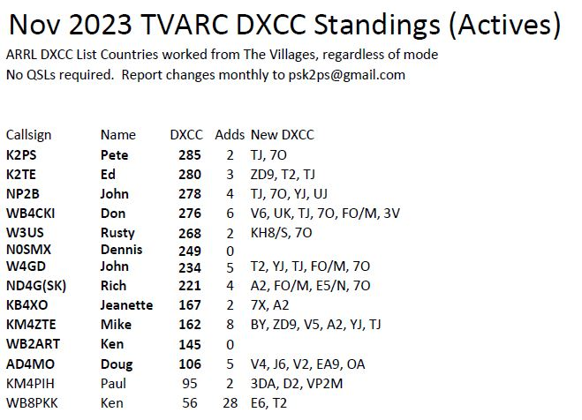

Slide 17
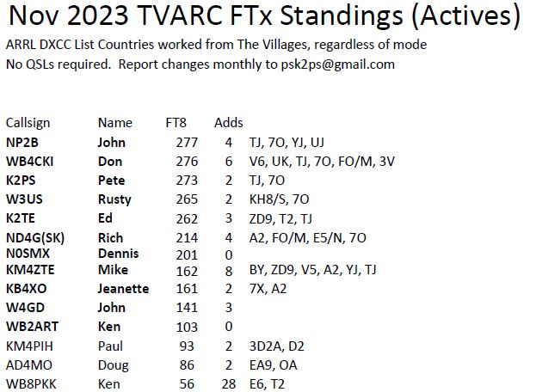

Slide 18
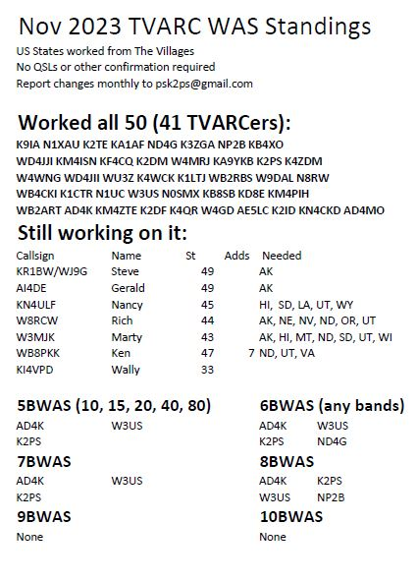

Slide 19
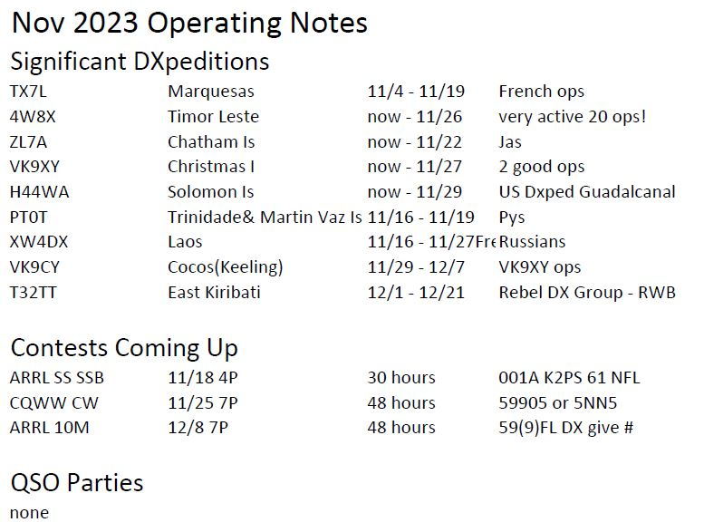

Slide 20
TVARC
Tonight’s Program
Tell Us About Your Antenna

